Slide 1
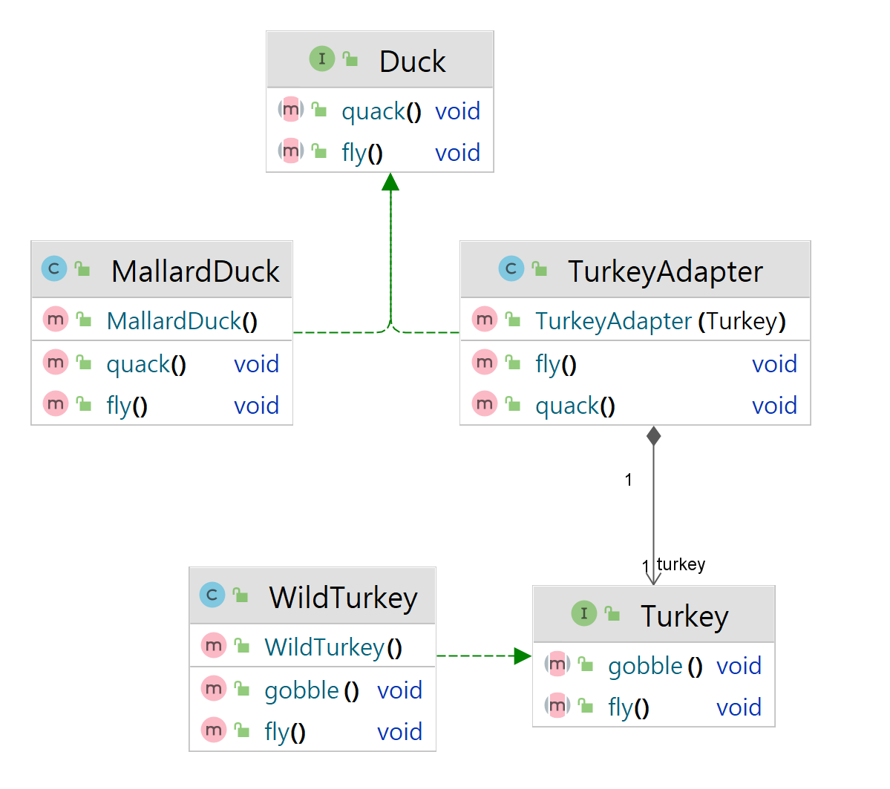
Target
Adapter
Adaptee

Slide 2
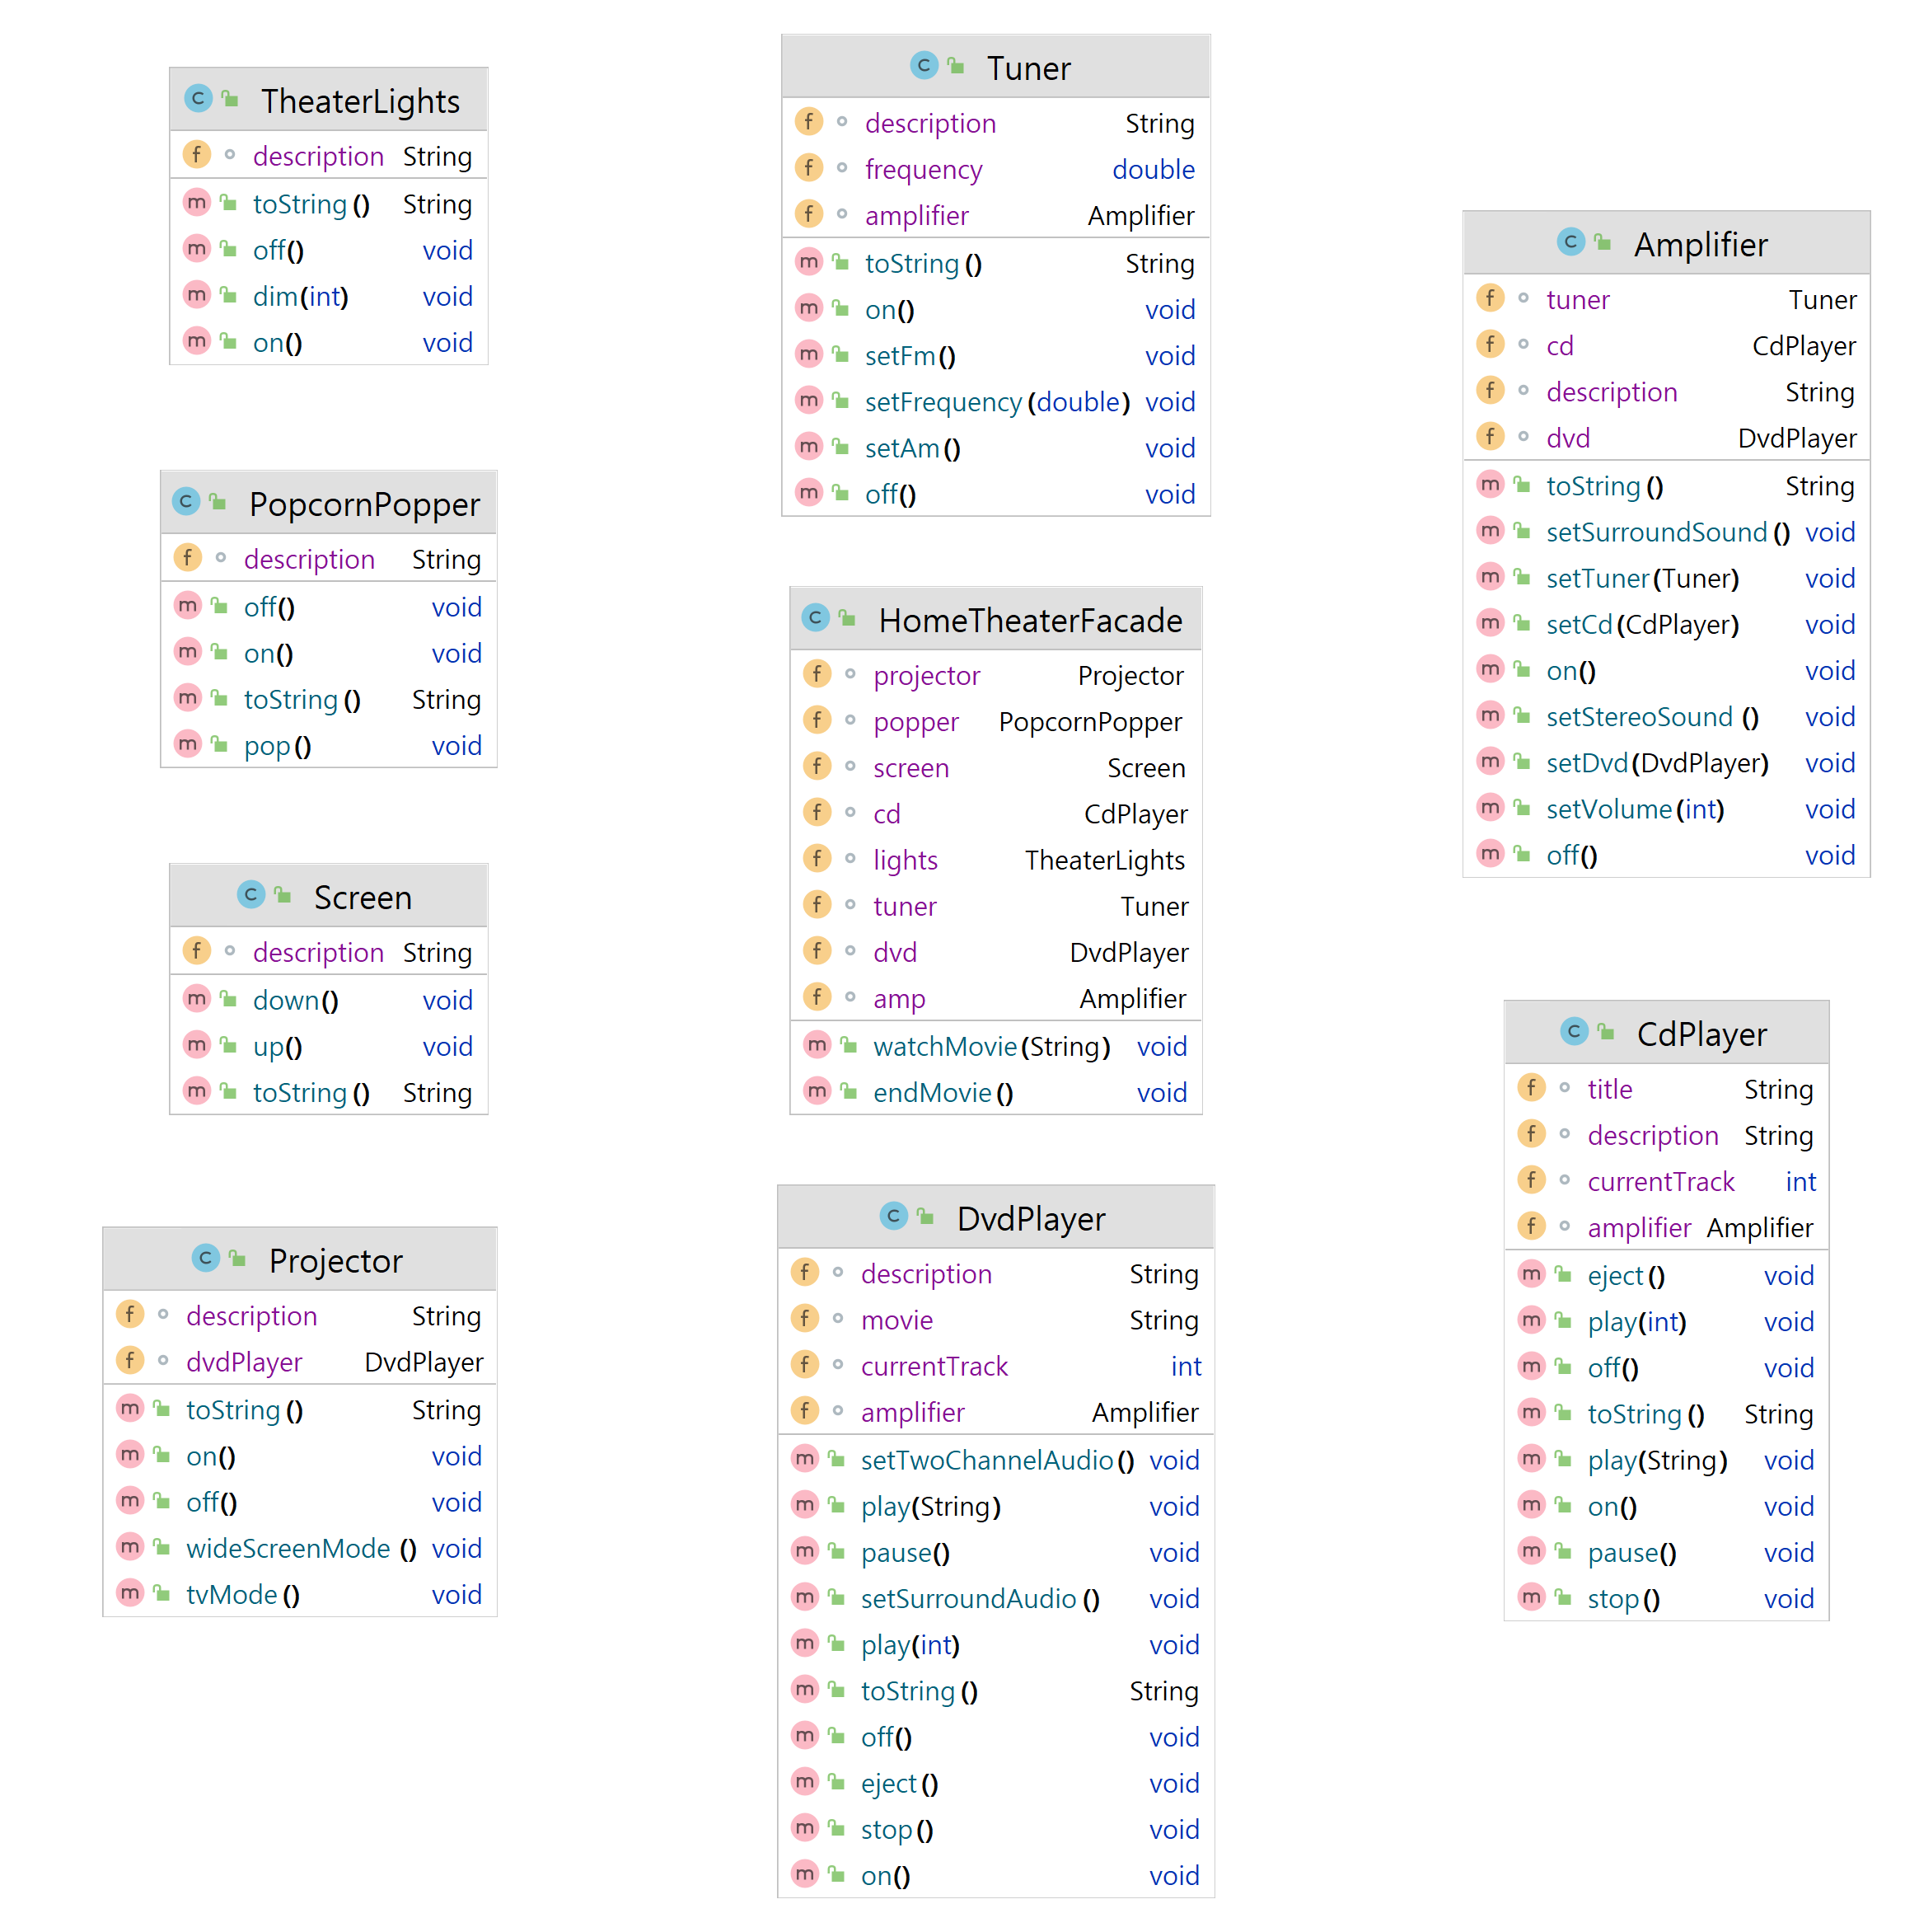
Sub System
Facade

Slide 3
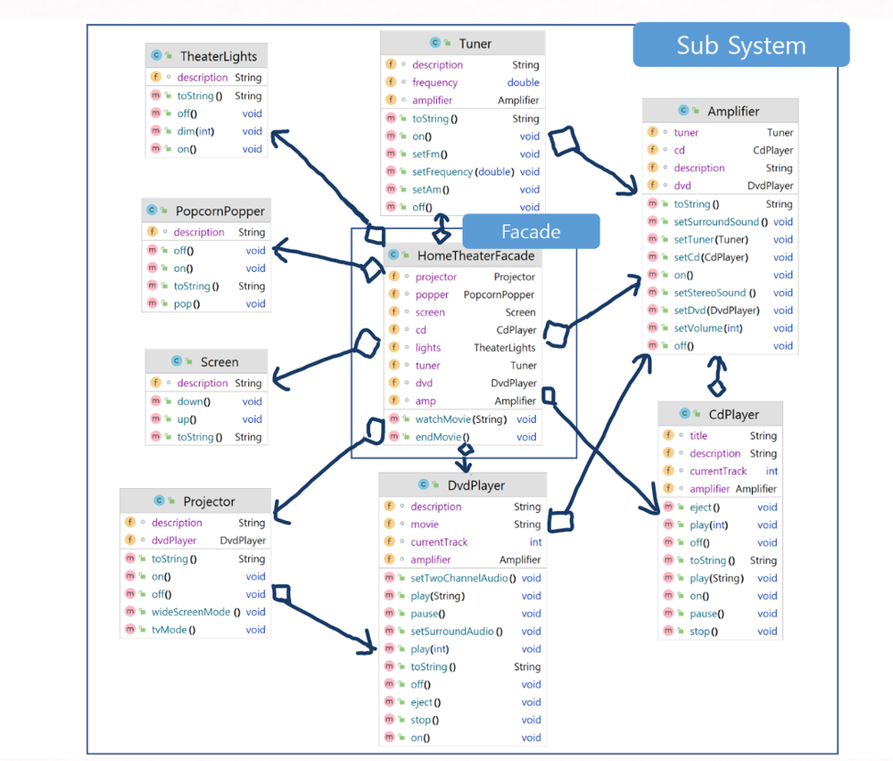

Slide 4
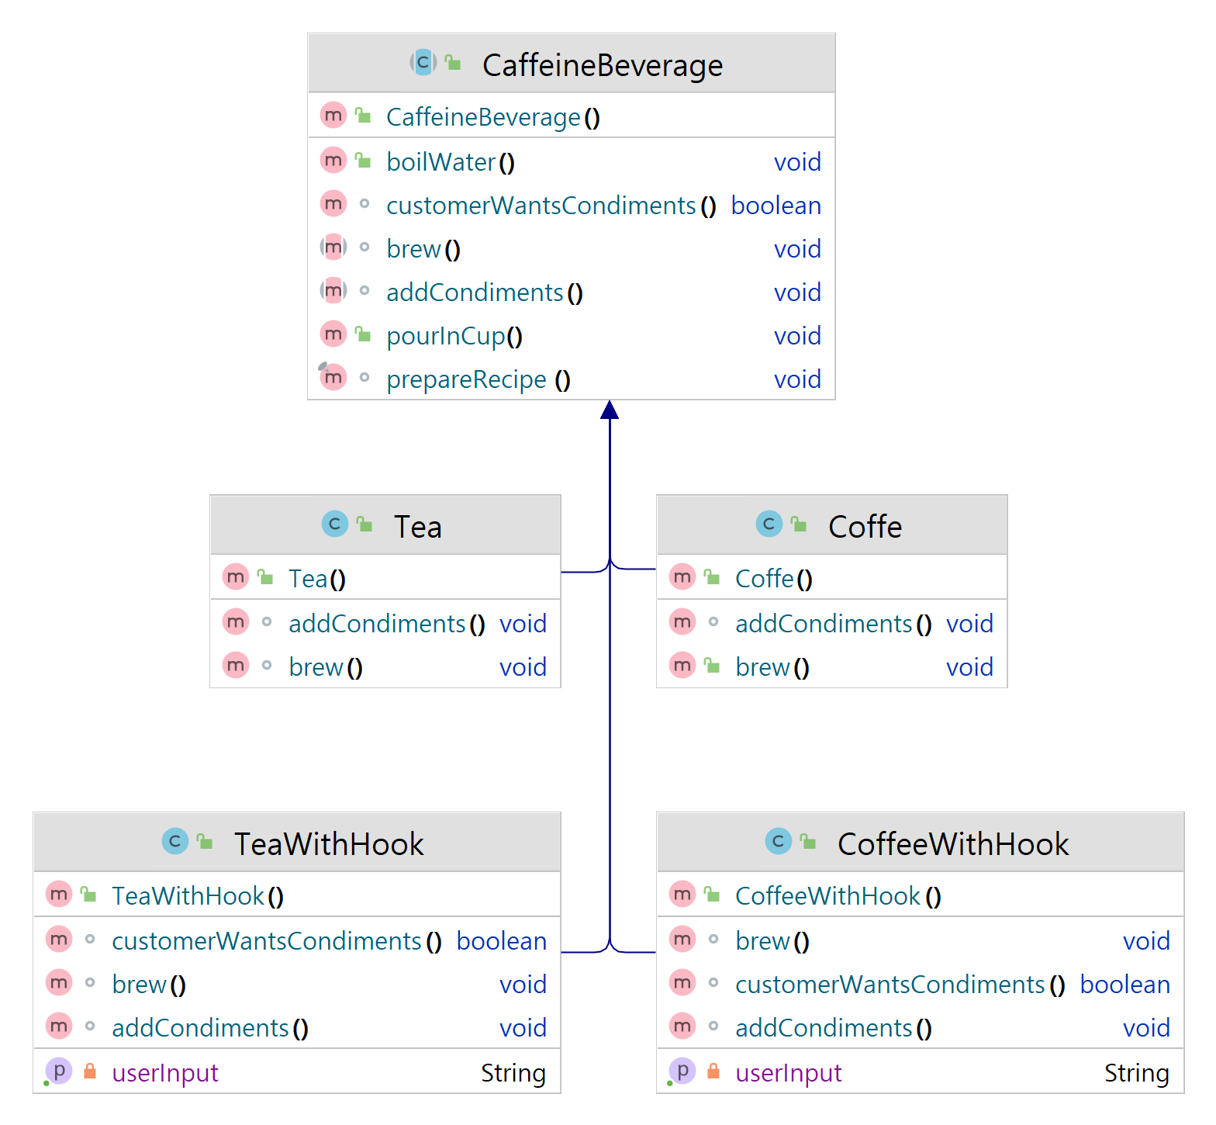
Abstract Class
Concrete Class
Concrete Class By Hook

